Slide 1
Welcome to MY Presentation

Slide 2
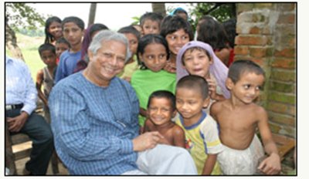
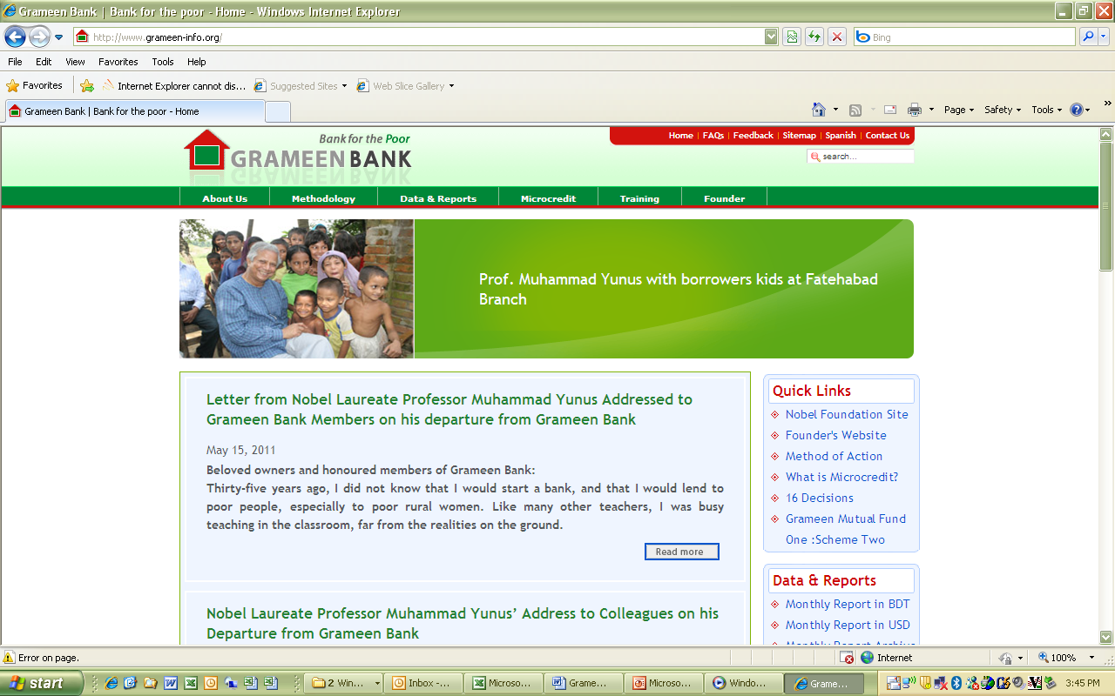
The Grameen Bank
Bringing Sustainability to Bangladesh’s Fight Against Poverty

Slide 3
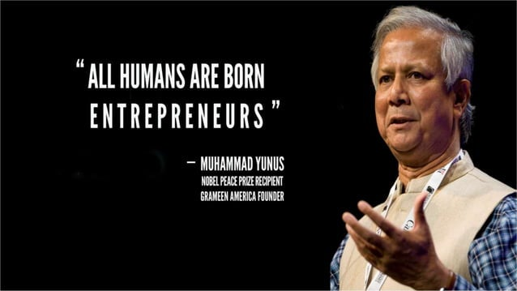
Mohammad Mehedi Hasan
22 FIN 039

Slide 4
Background
Microfinance organization and community development bank started in Bangladesh
Makes small loans (known as microcredit or “Grameen-credit") to the impoverished without requiring collateral
Gram which means "rural" or "village
Group-based credit approach
Accepts deposits, provides other services, and runs several development-oriented businesses including fabric, telephone and energy companies
Majority (98%) of its borrowers are women

Slide 5
Basic Information of Grameen Bank of last 5 years (amount million BDT)
Description | 2018 | 2019 | 2020 | 2021 | 2022
Number of groups | 1388316 | 1395370 | 1407042 | 1419639 | 1456775
Number of members | 9054303 | 92002176 | 9336847 | 9495443 | 10270013
Percentage of female members | 97 | 97 | 97 | 97 | 97
Number of branches | 2568 | 2568 | 2568 | 2568 | 2568
Loan Disbursement | 246810.30 | 254374.10 | 174930.96 | 182734.111 | 245079.17
Loan Outstanding | 153598.64 | 156721.10 | 142048.46 | 135040.50 | 152595.09
Total Deposit | 266064.36 | 243830.03 | 240989.52 | 241474.37 | 242102.03
Profit | 3485.29 | 4723.24 | 3486.45 | 493.32 | 2360.49

Slide 6
Total Deposit of Grameen Bank

Slide 7
Loan Disbursement of Grameen Bank

Slide 8
Loan Outstanding of Grameen Bank

Slide 9
Profit of Grameen Bank

Slide 10
Total Impact
Row Labels | Sum of LOAN DIS. | Sum of LOAN OUT. | Sum of DEPOSIT | Sum of PROFIT
2018 | 246810 | 153598 | 266064 | 3485
2019 | 254374 | 156721 | 243830 | 4723
2020 | 174930 | 142048 | 240989 | 3486
2021 | 182734 | 135040 | 241474 | 493
2022 | 245079 | 152595 | 242102 | 2360
Grand Total | 1103927 | 740002 | 1234459 | 14547

Slide 11
Pie Chart

Slide 12
Sources
http://www.grameen.com
en.wikipedia.org/wiki/Grameen_Bank

Slide 13
Thank You

